Slide 1
Minster Community Discernment Day
Welcome.
Please sit with your Church group.
Feel free to read the storyboards around the room.
We start at 10.00

Slide 2
What’s happened so far?
We know why this process is important (synod decision) and it is our turn to be involved.
We have talked about the rough shape of how this Minster Community could form.
We have done the Conversation Prompts & Storyboards within our Church Communities – we started to bring this together at our last big meeting
Coordinating Group has been set up with people volunteering to be part of it

Slide 3
Worth remembering…
God speaks through this!
We are looking for how God is speaking to us through this process.
This is a process, exploring how this potential Minster Community could form.

Slide 4
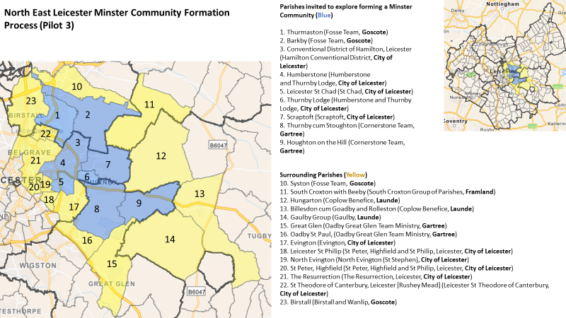

Slide 5
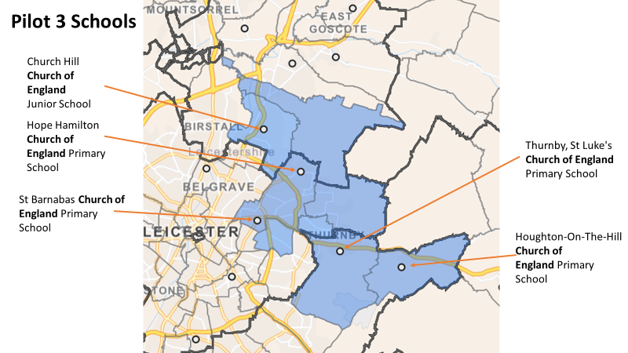

Slide 6
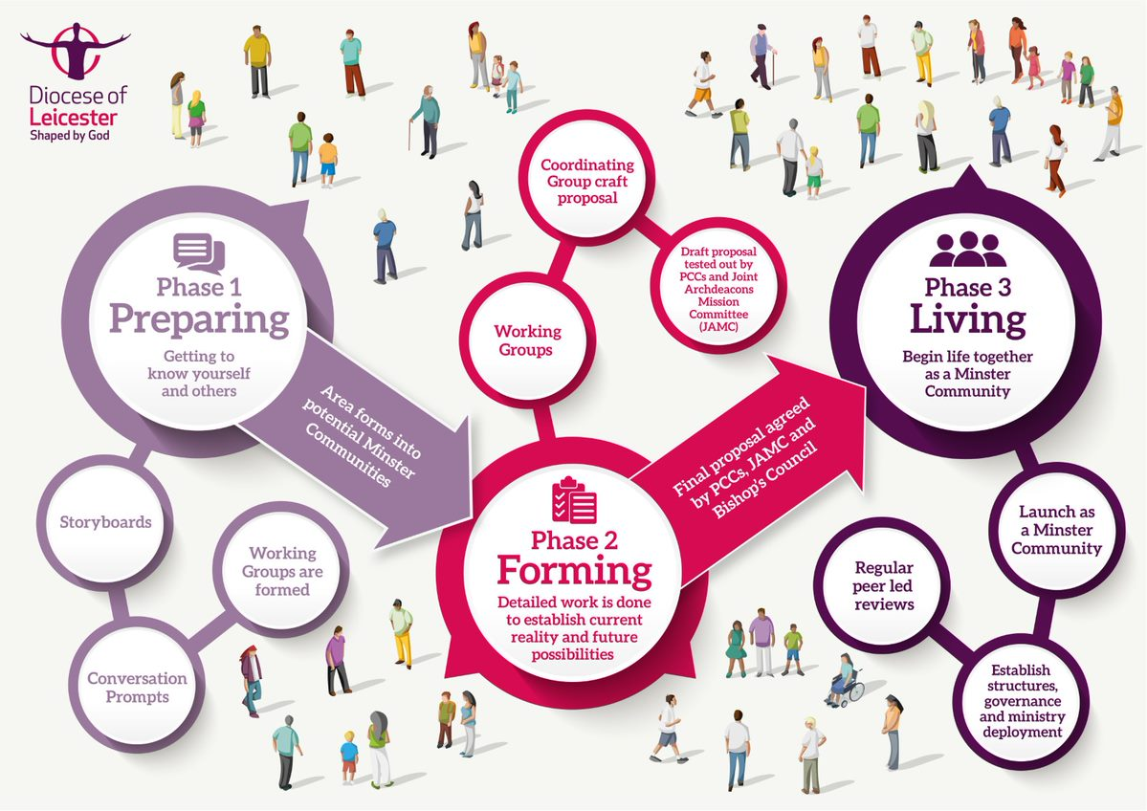

Slide 7
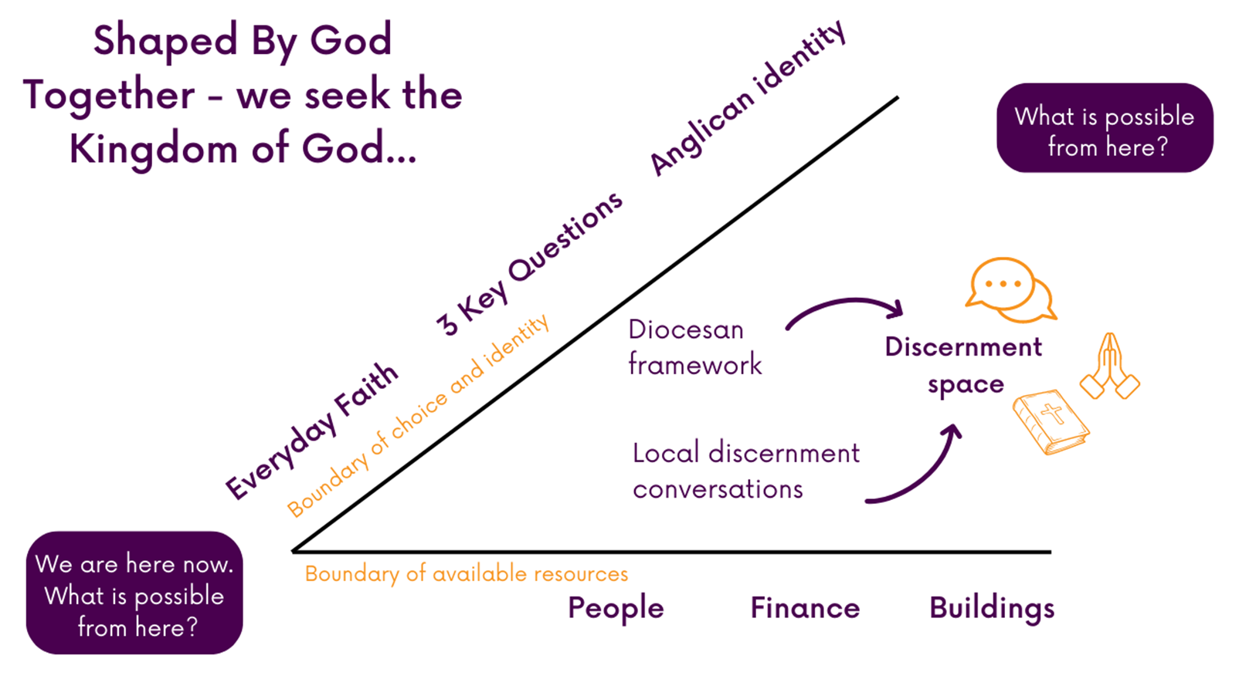

Slide 8
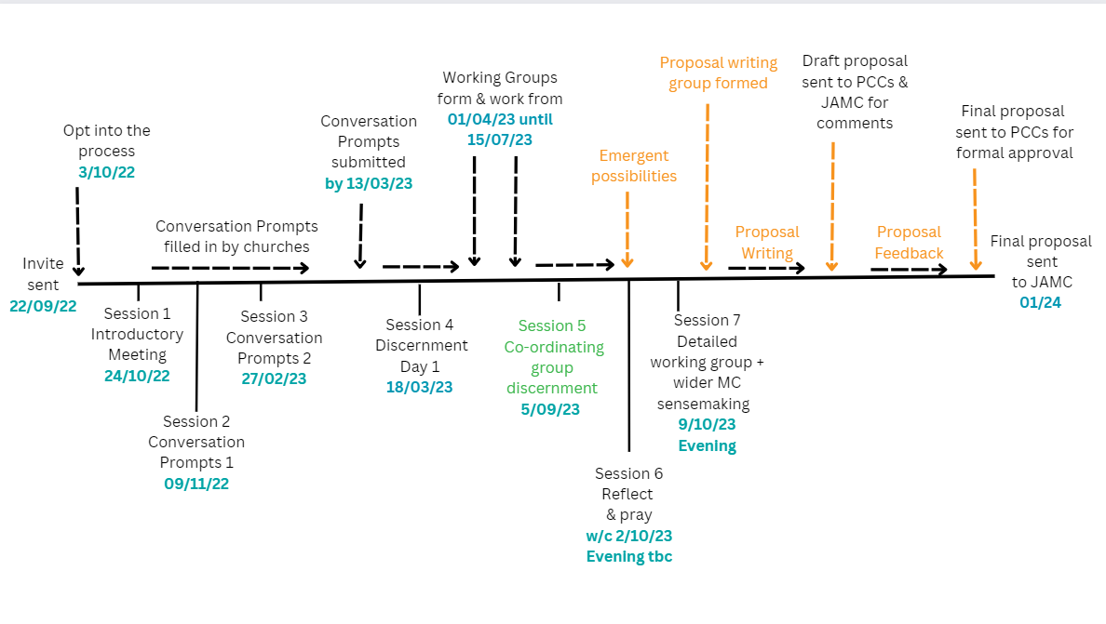

Slide 9
Aim for today
To build relationships, build trust, and discover more about each other and our churches.
To look for patterns and notice what God may be saying to us through our Conversation Prompts and Storyboards
To work out where our energy and focus needs to be when thinking about working effectively together as a Minster Community.
By the end of this meeting we will have identified Working Groups to focus on particular aspects of minster community life – to help move us forward in this process

Slide 11
How are we going to work together today?
Listen well and if we disagree we disagree well
Keep God in the room
Car park
?

Slide 12
Dwelling in God’s Word
Matthew 13:1-9 (19-23)
13 That same day Jesus went out of the house and sat by the lake. ² Such large crowds gathered around him that he got into a boat and sat in it, while all the people stood on the shore. ³ Then he told them many things in parables, saying: “A farmer went out to sow his seed. ⁴ As he was scattering the seed, some fell along the path, and the birds came and ate it up. ⁵ Some fell on rocky places, where it did not have much soil. It sprang up quickly, because the soil was shallow. ⁶ But when the sun came up, the plants were scorched, and they withered because they had no root. ⁷ Other seed fell among thorns, which grew up and choked the plants. ⁸ Still other seed fell on good soil, where it produced a crop—a hundred, sixty or thirty times what was sown. ⁹ Whoever has ears, let them hear.”

Slide 13
¹⁹ When anyone hears the word of the kingdom and does not understand it, the evil one comes and snatches away what is sown in the heart; this is what was sown on the path. ²⁰ As for what was sown on rocky ground, this is the one who hears the word and immediately receives it with joy, ²¹ yet such a person has no root but endures only for a while, and when trouble or persecution arises on account of the word, that person immediately falls away. ²² As for what was sown among thorns, this is the one who hears the word, but the cares of this age and the lure of wealth choke the word, and it yields nothing. ²³ But as for what was sown on good soil, this is the one who hears the word and understands it, who indeed bears fruit and yields in one case a hundredfold, in another sixty, and in another thirty.”
Notes:
10 mins

Slide 14
Matthew 13:1-9 (19-23)
13 That same day Jesus went out of the house and sat by the lake. ² Such large crowds gathered around him that he got into a boat and sat in it, while all the people stood on the shore. ³ Then he told them many things in parables, saying: “A farmer went out to sow his seed. ⁴ As he was scattering the seed, some fell along the path, and the birds came and ate it up. ⁵ Some fell on rocky places, where it did not have much soil. It sprang up quickly, because the soil was shallow. ⁶ But when the sun came up, the plants were scorched, and they withered because they had no root. ⁷ Other seed fell among thorns, which grew up and choked the plants. ⁸ Still other seed fell on good soil, where it produced a crop—a hundred, sixty or thirty times what was sown. ⁹ Whoever has ears, let them hear.”
Notes:
10 mins

Slide 15
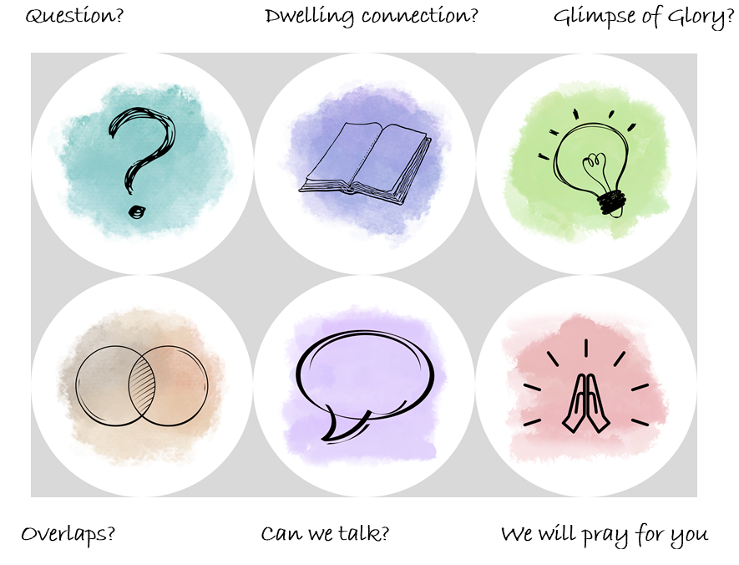
STORYBOARDS

Slide 16
How did you learn to cook?
Write down on a post-its how your learnt to cook.
In small groups tell each other your stories
Then use the post-it’s to group the stories – where are there similarities or difference?
What does that tell you?

Slide 17
CONVERSATION PROMPTS
Where have we got a lot of high or low numbers?
Where do we have highs and lows but not much in the middle?
Are there any links between the numbers?
Are there any patterns?
What are those patterns telling us?
Take time to go and have a look at the theme and insights board – what is that telling you?

Slide 18
Join up...
Two groups join together and share their noticing
One person from each group present to the other group
Are there any things noticed by all? Anything new?
What is this telling us?
Use the scribble sheets

Slide 20
Lunch
Do whatever you need to in this time
You could go back into your church groups and talk about what you’ve noticed.
You may need some space, you could go out for a walk
Or just have a chat and get to know each other better
Notes:
45 mins

Slide 22
What should our working groups focus on?
What does that mean we need to focus on?
What do we need more information about, more data, further insight, to be able to have more detailed conversations?
In your small group you have 5 sticky dots – stick them onto the dials you think need to be formed into working groups

Slide 26
Working groups
Working groups will have the next 8-12 weeks to meet, discuss and put together proposals – this may be done in person or online
There are sign up sheets on each working group – sign yourself up or suggest someone you know from your church that would be great for the task (committing to speaking to them about it)
Members of the Coordinating group will then be part of leading these working groups and will be in touch in due course to get started

