Slide 1
North East Leicester Timeline
Process & Wedge Summary

Slide 2
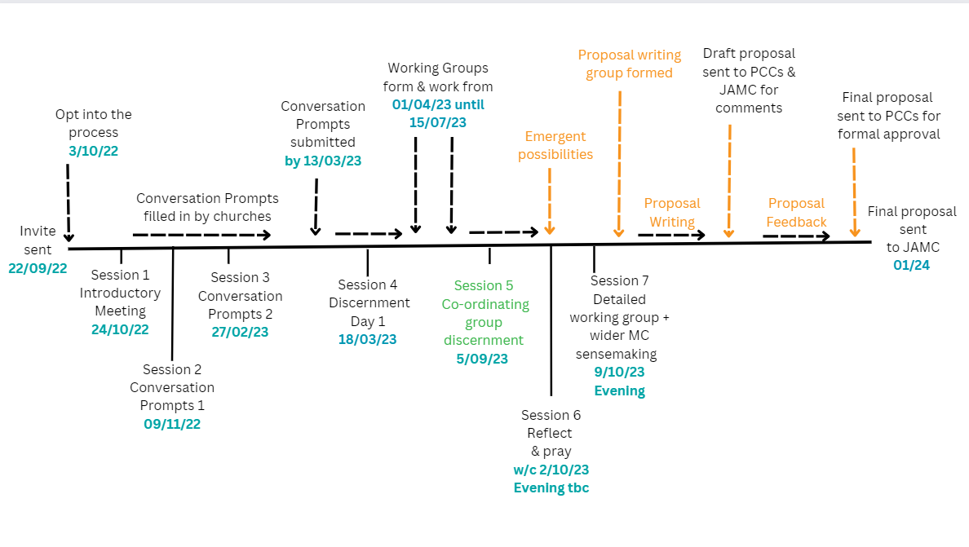

Slide 3
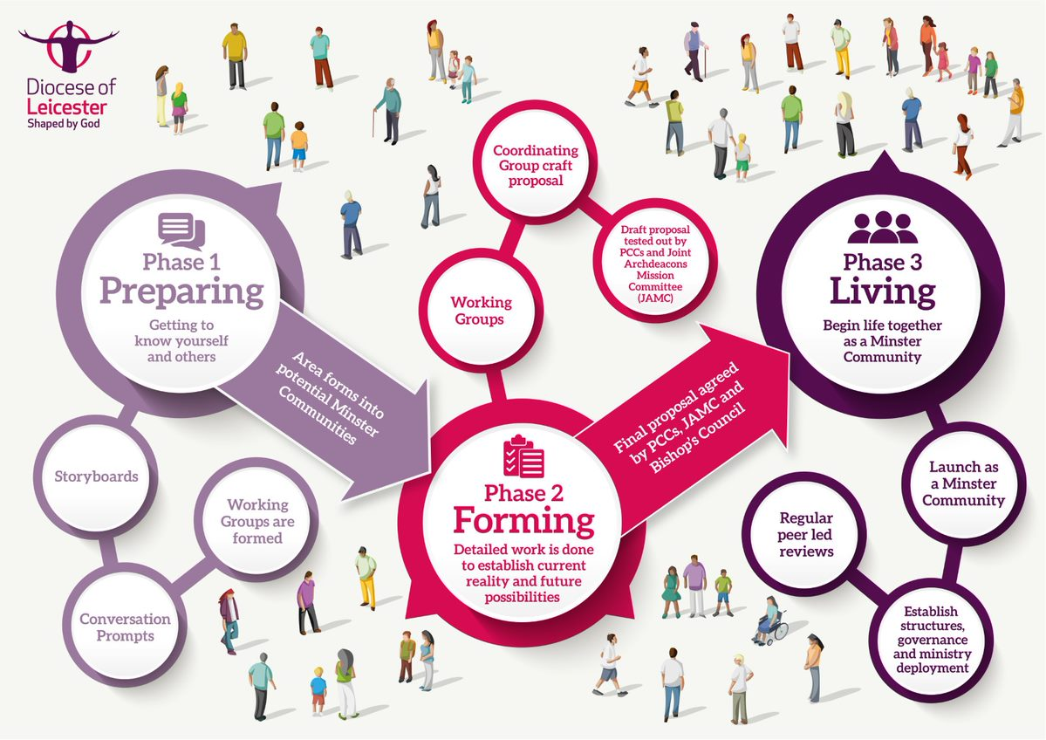

Slide 4
